Slide 1
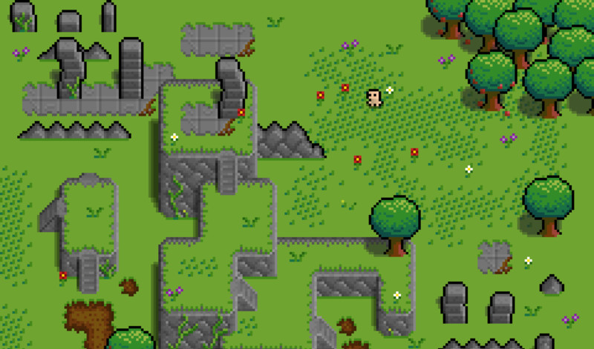

Green Sky Games
TL5 Hengyi Weekly Report

Slide 2

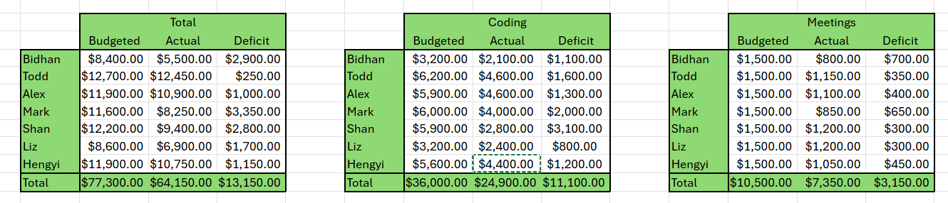
Gantt Chart - Summary
Overall development is on track
83% of the total budget has been used
Spending aligns with the current progress
Financial status remains stable and under control

Slide 3
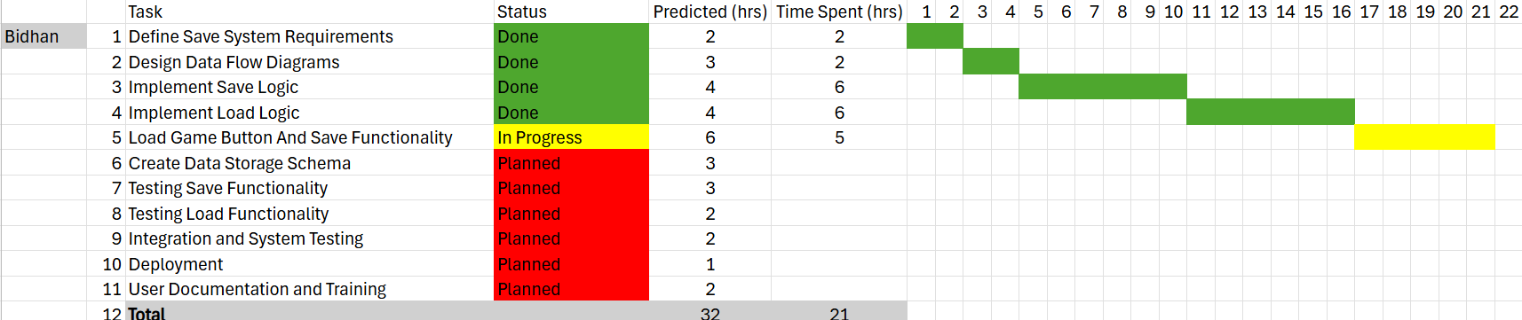
Gantt Chart –TL1 Bidhan
Progress: No Reported
Next Step: No Updates

Slide 4
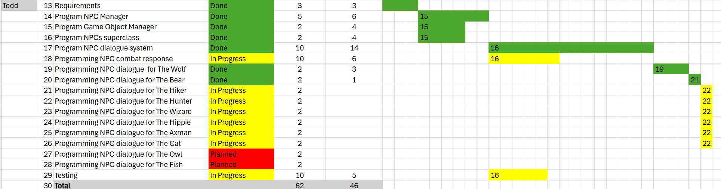
Gantt Chart –TL2 Todd
Progress:
Added more NPCs to the map: fish, owl, hunter, and wizard
Added dialogue details
Fixed dialogue system bugs
Next Step:
Finish all remaining dialogue system
Finish remaining coding tasks
May add more fun story if have time

Slide 5
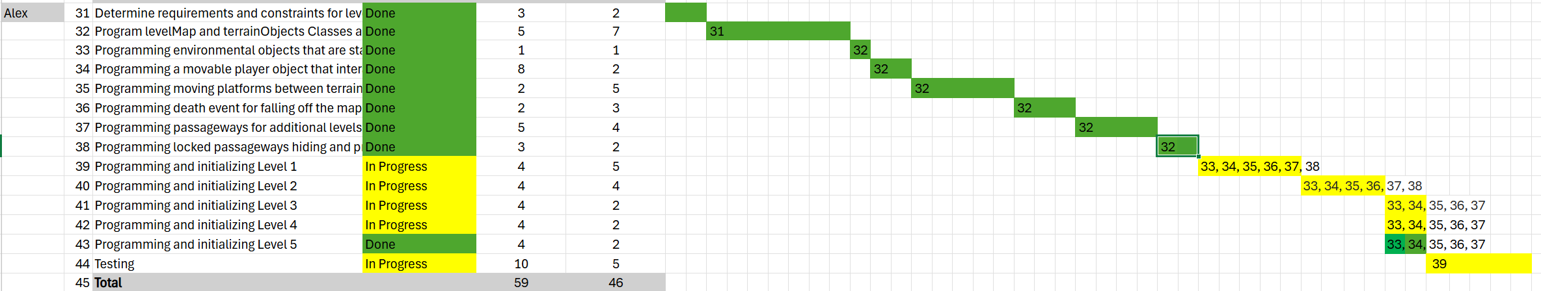
Gantt Chart –TL2 Alex
Progress:
Updated Level 1 map layout
Added lockable passageways and sliding doors
Refined map layout inside level boundaries
Next Step:
Walk through the entire map for testing
Fix bugs
provide support to teammates

Slide 6
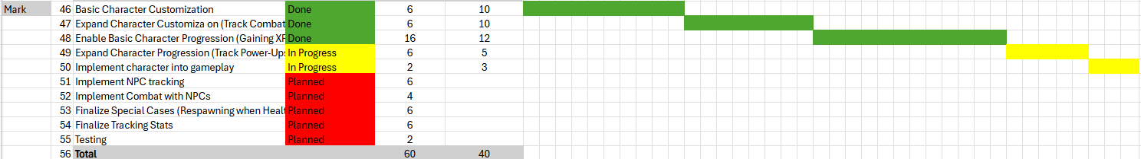
Gantt Chart –TL3 Mark
Progress:
Imported Red Riding Hood’s sprite as the main character
Added a combat animation that can be activated when you press the Spacebar.
Next Step:
Update combat system

Slide 7
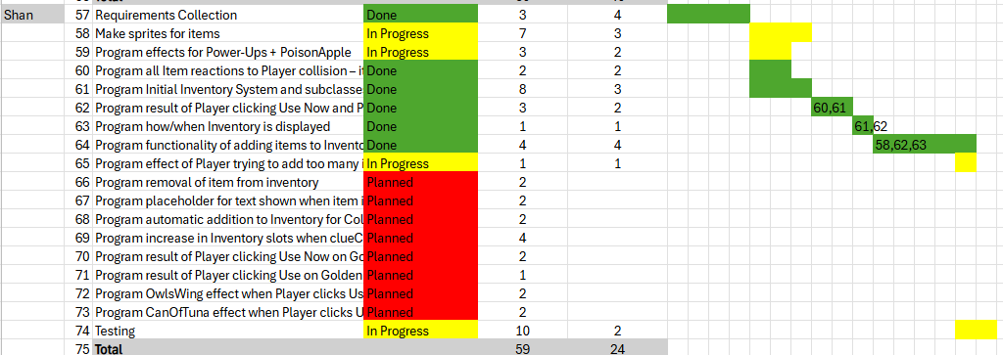
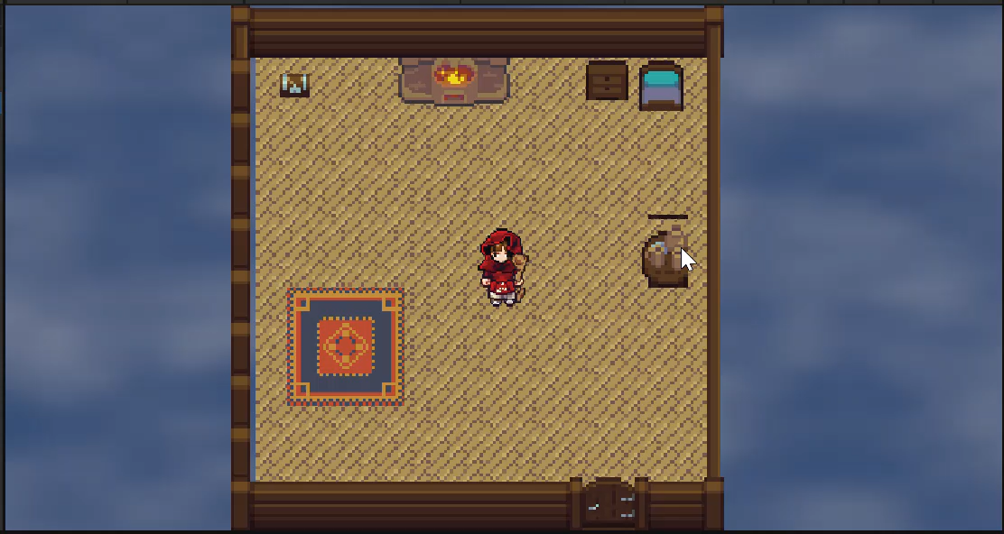
Gantt Chart –TL4 Shan
Progress:
Fixed powerup system
Added the last new collectible: Enchanted Berry
Added descriptions of inventory items
Next Step:
Update collectible system and inventory

Slide 8
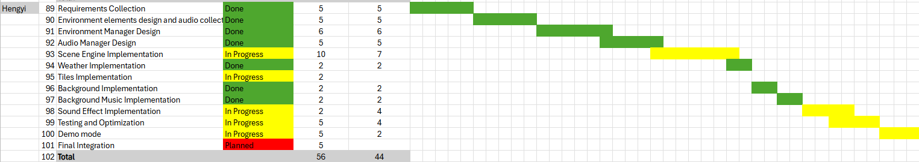
Gantt Chart –TL5 Hengyi
Progress:
Finished Background System and Weather System
Added NPCs’ dialogue sound effects and dialogue box sound effects
Added Demo mode
Next Step:
Fix NPCs dialogue system
Update demo mode videos
Add green sky scene
Notes:
NPC被击败 green sky
飓风
Tornado
Green Sky screen become green

Slide 9
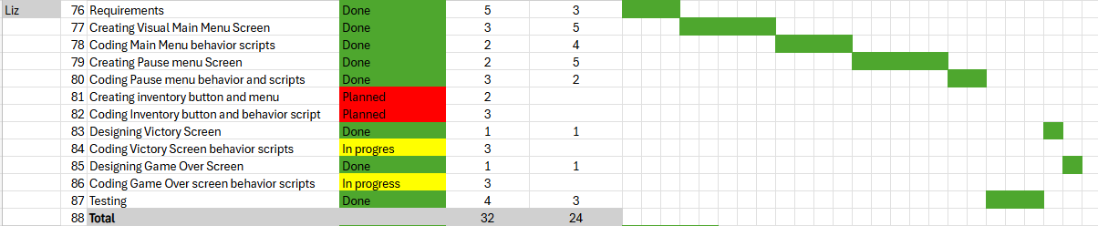
Gantt Chart –TL6 Liz
Progress:
Added victory screen and game-over screen
Linked new screens to the Game Screen via button interaction
Next Step:
Update menu and screens
Code the menu system

Slide 10
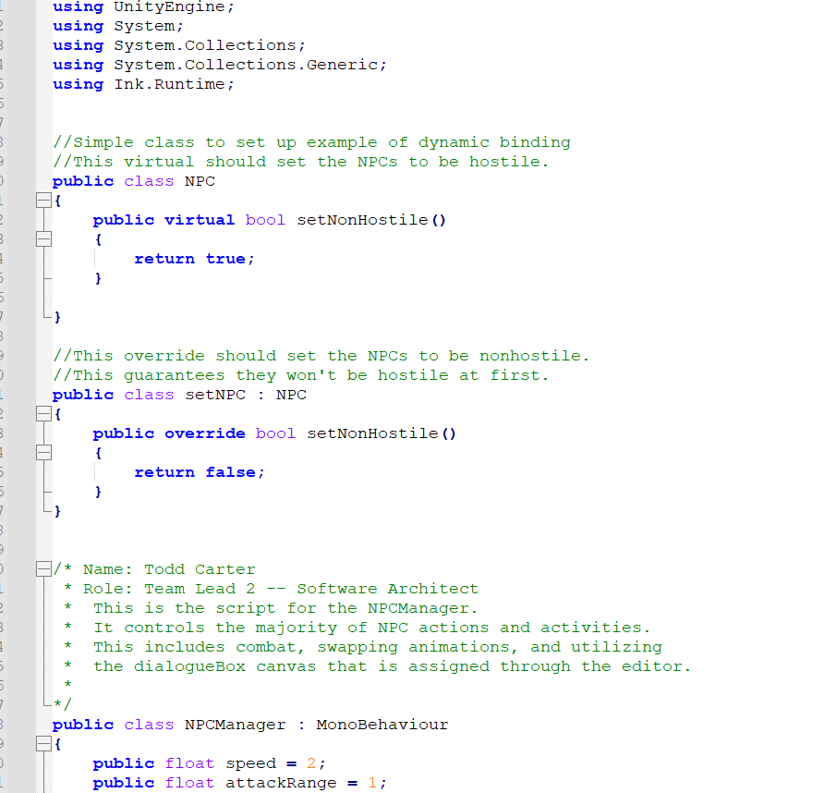
Dynamic Binding -TL2 Todd

Slide 11
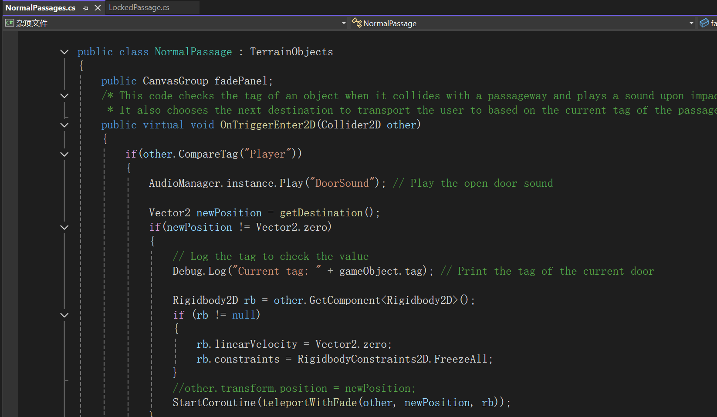
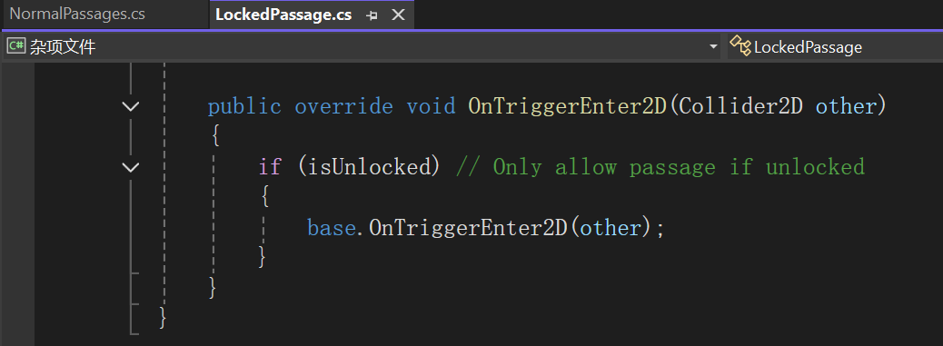
Dynamic Binding - TL2 Alex

Slide 12
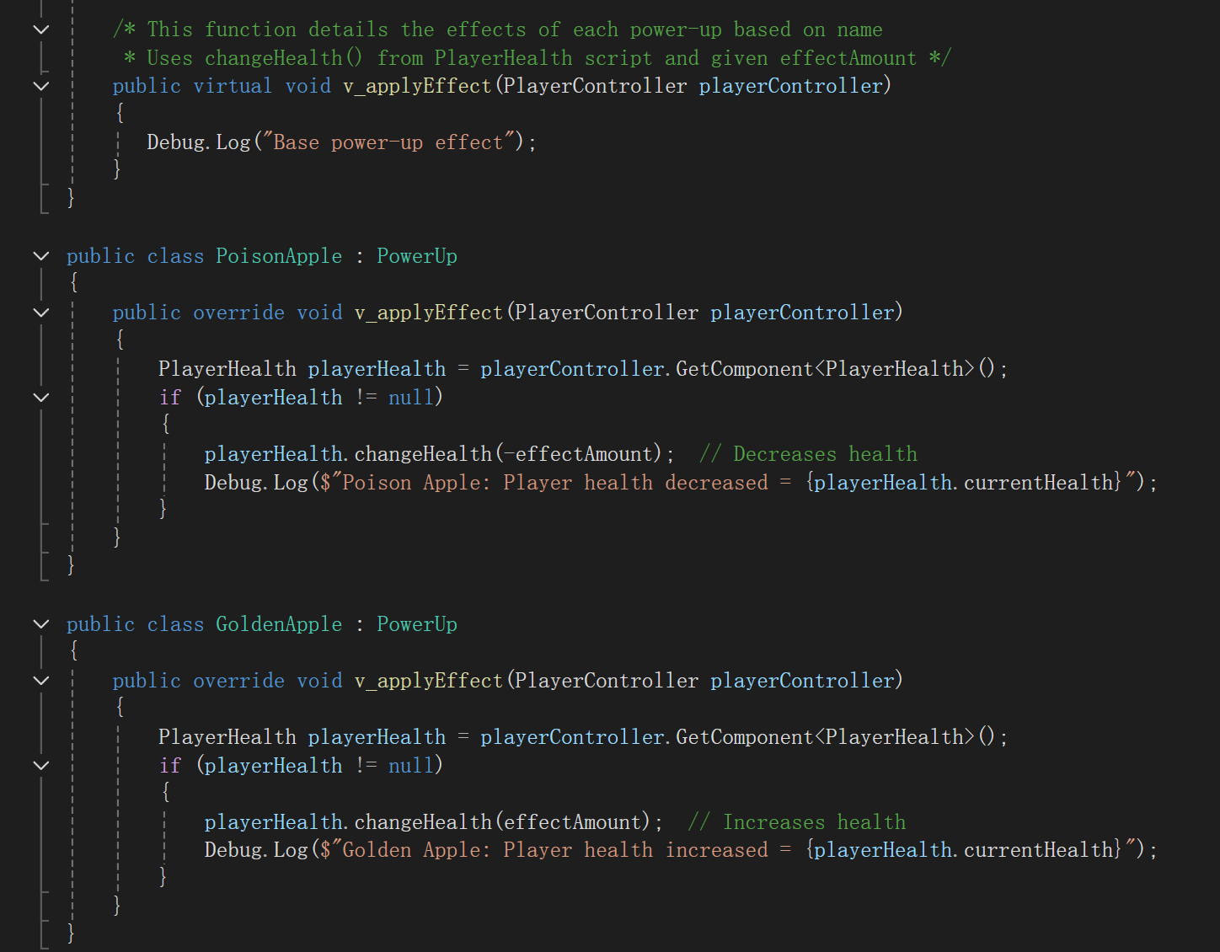
Dynamic Binding - TL4 Shan

Slide 13
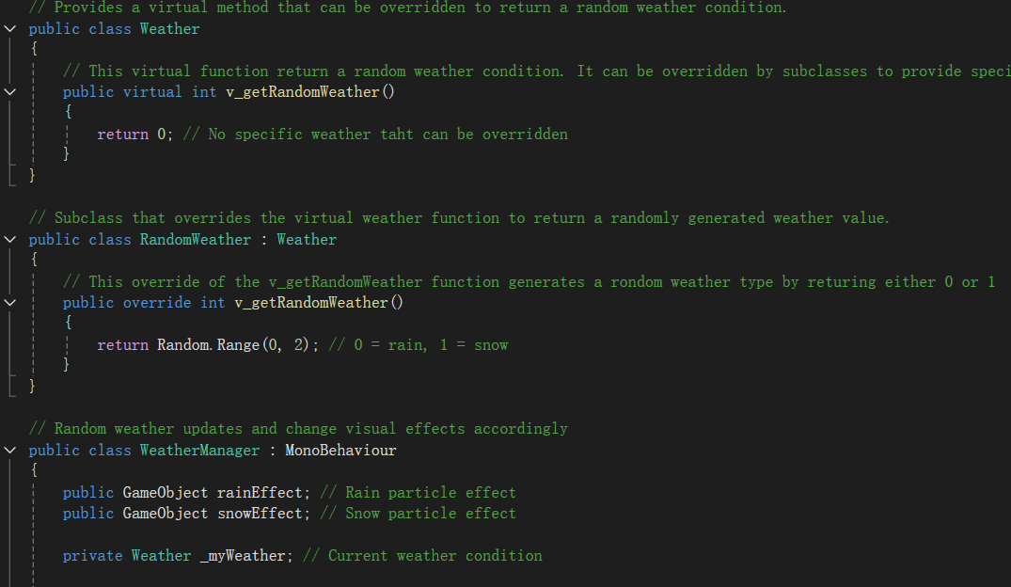
Dynamic Binding – TL5 Hengyi

Slide 14
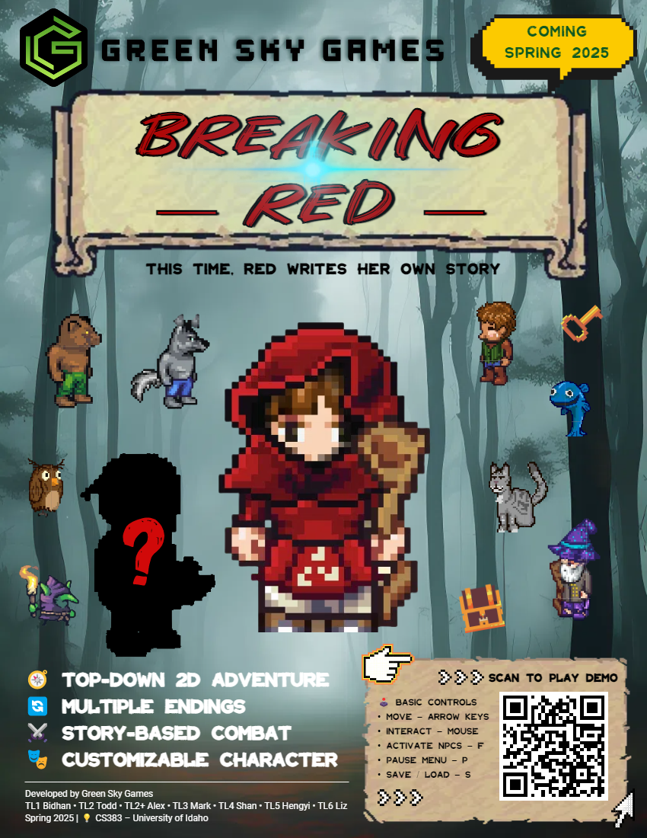
Game Poster

Slide 15
Unity Time Run the Game Show Demo Modes

Slide 16
THANKS!

